Slide 1
Ansār Leadership Conference (ALC)
Baitus-Samee Mosque
Houston, TX
January 14 - 15, 2017
Department of Umumi

Slide 2
WhatsApp – Ansarullah USA
Objective of the forum is to ask Majlis related questions, increase awareness of Ansārullāh programs, share success stories, and promote mutual brotherhood.
New communication channel for Majlis to use

Slide 3
WhatsApp – Responses
Just wanted to let you know that as group was having too many messages, which I found were of no relevance, so I had no choice but to withdraw
Members post too much junk, can’t handle It
I don’t have unlimited data, can you ask members not to post too many pictures of the same event

Slide 4
WhatsApp – Do’s
Zo’amā: Ask questions from Qā'ideen about their programs and help they can provide you.
Nāzimeen Aala: Share how you are succeeding in your region, what new things you're trying in your regional Ijtima.
Qā'ideen: should promote their services and initiatives.

Slide 5
WhatsApp – Don't
News items, be they political, religious or related to a certain country.
Death notices.
Feel compelled to say "Jazakallah"
Long back and forth conversation between just two people

Slide 6
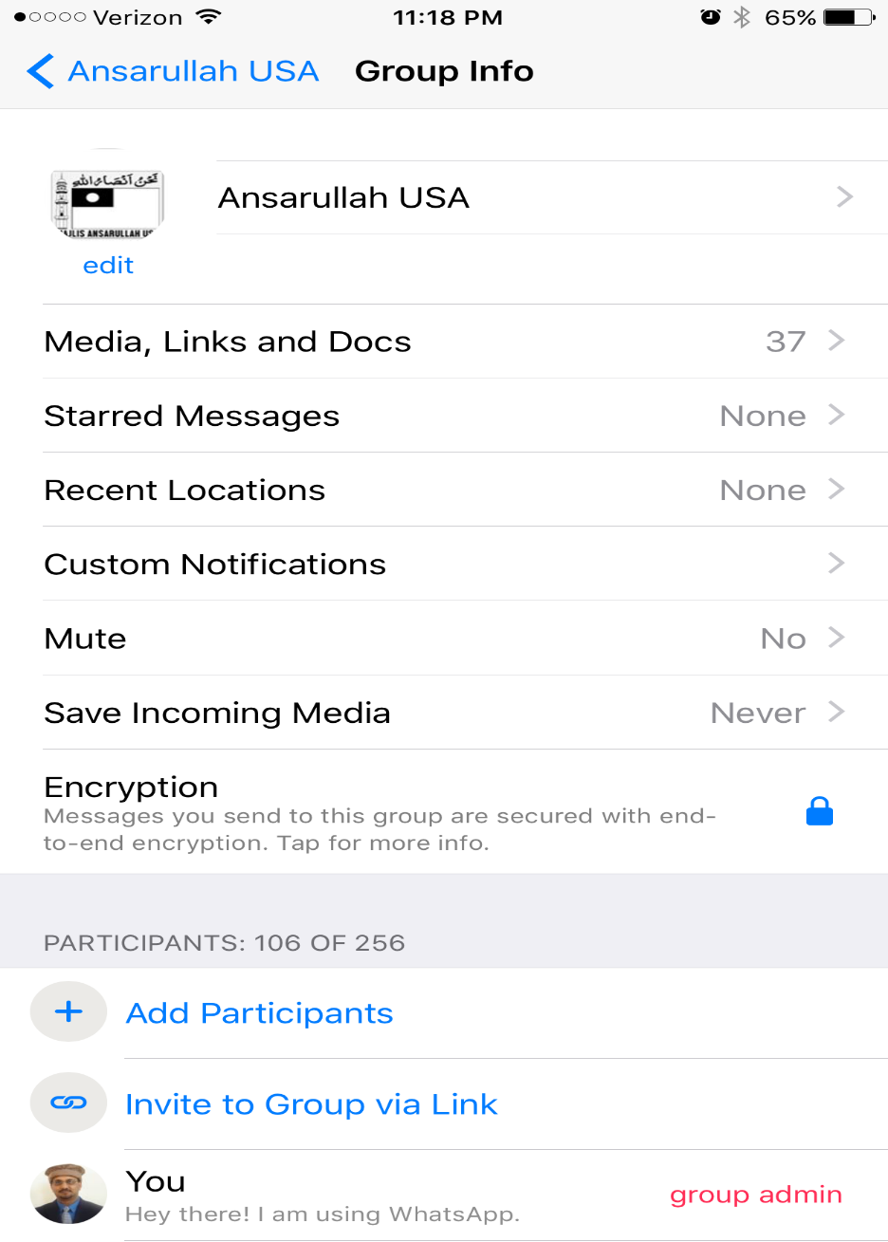
WhatsApp – Storage usage
Open the Ansarullah USA Group
Click on the group to open group info
Change ‘Save Incoming Media’ to Never

Slide 7
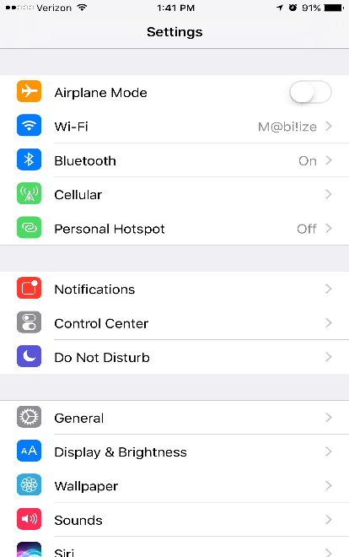
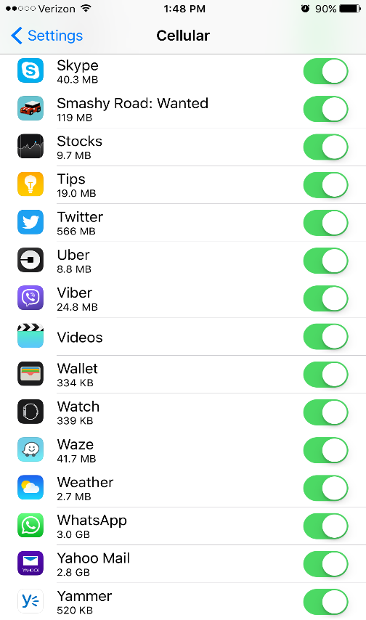
WhatsApp – Cellular Data
Under Settings -> Cellular
Find WhatsApp and turn off cellular data use

Slide 8
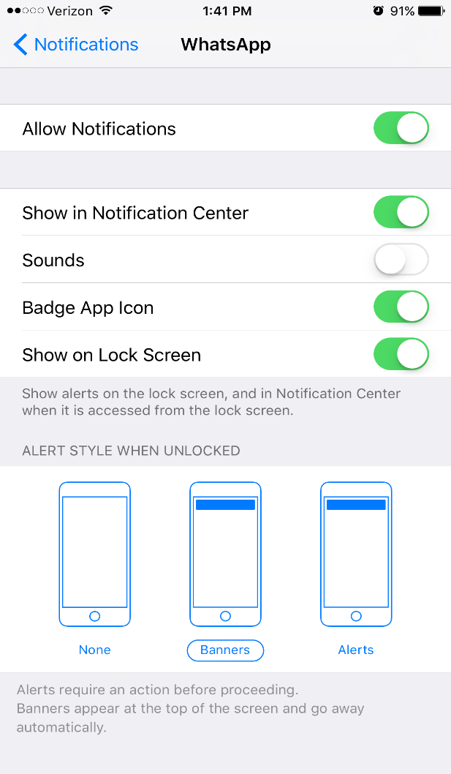
WhatsApp – Mute Sound
Under Settings -> Notification
Find WhatsApp and turn off sound

Slide 9

Jazakallah

